Slide 1

Data 101 Final Project
Newton S Jacob

Slide 2

The Dataset
https://www.kaggle.com/datasets/thedevastator/how-much-sleep-do-americans-really-get
This dataset includes data on the average number of hours per day Americans spend sleeping, broken down by age group, sex, and activity. This can be used to understand patterns in sleep habits among different groups of people, as well as how these patterns may change over time.

Slide 3
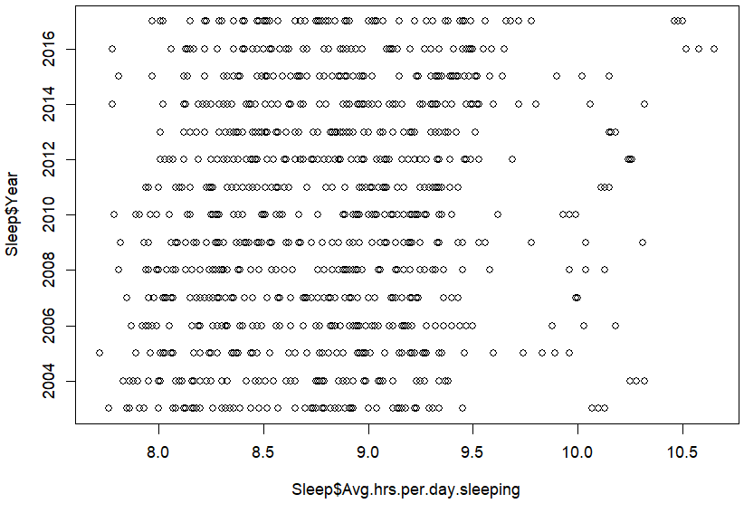
Looks like people do sleep 8 Hours or more on average throughout the years as the year is not a factor that effects sleep much.
Also in 2016 and after there seems to be a few instances people have slept on average more than 10.5 hours.

Slide 4
Using Bayes Theorem to find the probability of people sleeping more than 9 hours on average
Prior: The probability that Americans Sleep 9 hours or more on average VS Who sleep less
table(Sleep$Avg.hrs.per.day.sleeping>=9)
False True
600 345
nrow(Sleep[Sleep$Avg.hrs.per.day.sleeping>=9,])/nrow(Sleep)
0.3650794
nrow(Sleep[Sleep$Avg.hrs.per.day.sleeping<9,])/nrow(Sleep)
0.6349206
Without other information, 36.5% of American Sleep 9 hours or more and 63.5% Sleep less than 9 hours.
P(G9)= 0.3650794
P(L9)= 0.6349206

Slide 5

What if it is a weekend or holiday?
table(Sleep$Avg.hrs.per.day.sleeping>=9,Sleep$Type.of.Days)
All days Nonholiday weekdays Weekend days and holidays
FALSE 260 292 48
TRUE 55 23 267
P(Holiday) = 315/945 = 0.3333333
P(Holiday|G9) = 267/345 = 0.773913
P(Holiday|L9) = 48/600 = 0.08
P(G9|Holiday) = (0.773913*0.3650794)/ 0.3333333 = 0.8476192
P(L9|Holiday) = (0.08*0.6349206)/0.3333333 = 0.152381

Slide 6
New information, implementation and limitations of the data.
What we learned:
The average hours of sleep a person gets is greatly effected by the day, whether it is a weekday or a holiday.
When it is a holiday people sleep on average 9 hours or more.
A lack of sleep at night can make you cranky the next day. And over time, skimping on sleep can mess up more than just your morning mood. Studies show getting quality sleep on a regular basis can help improve all sorts of issues, from your blood sugar, mood, Health even your workouts.
People sleep more and better on holidays which is very beneficial that mean there needs to be more holidays. Short-term down time can have long-term payoffs.
Limitations : There are many factors affecting the sleep of an individual like the environment or their diet and so limits the possibilities of using this data. Like to study the effect of sleep deprivation on health, to understand the role of sleep in regulating mood and behavior, to examine the relationship between sleep and cognitive function.

